Slide 1
PICTOGRAM CHART

Slide 2
PICTOGRAM
Also known as pictograph chart, pictorial chart, pictorial unit charts and icon charts.
Uses a series of repeated icons to visualize simple data.
Uses icons to give a more engaging overall view of small sets of discrete data.

Slide 3
PICTOGRAM
Typically, the icons represent the data’s subject or category.
It uses icons or pictures in relative sizes to highlight some data pattern and trends.
They are commonly viewed in business communications or news articles to visually compare data.

Slide 4
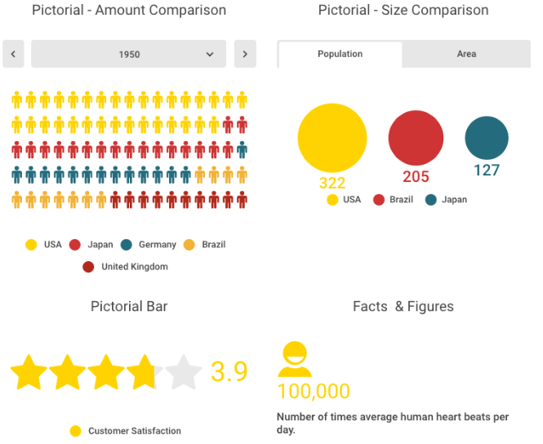
USES OF PICTOGRAM

Slide 5
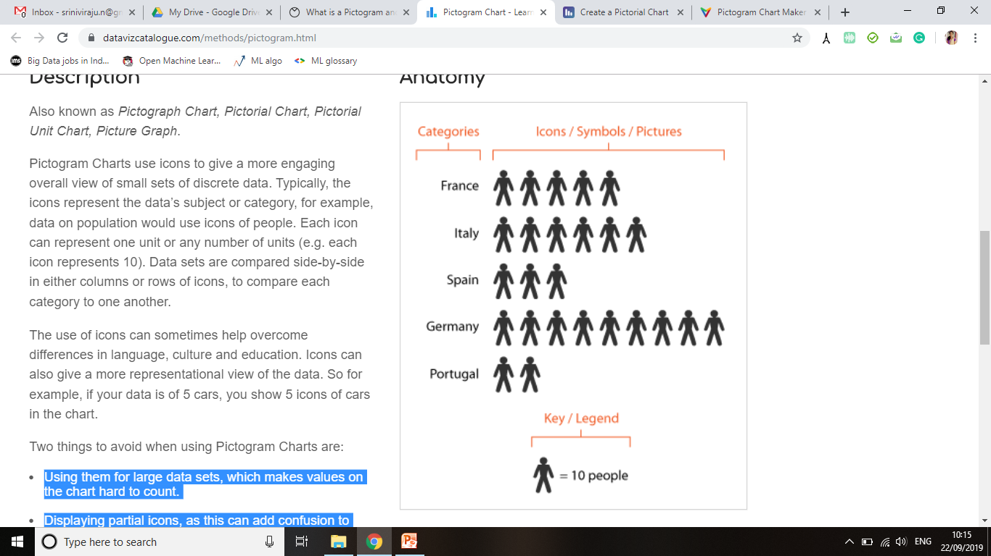
EXAMPLE

Slide 6
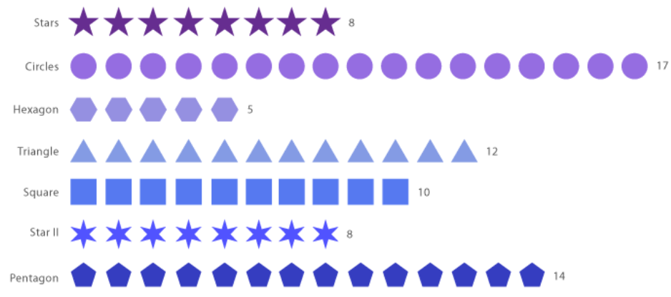
EXAMPLE

Slide 7
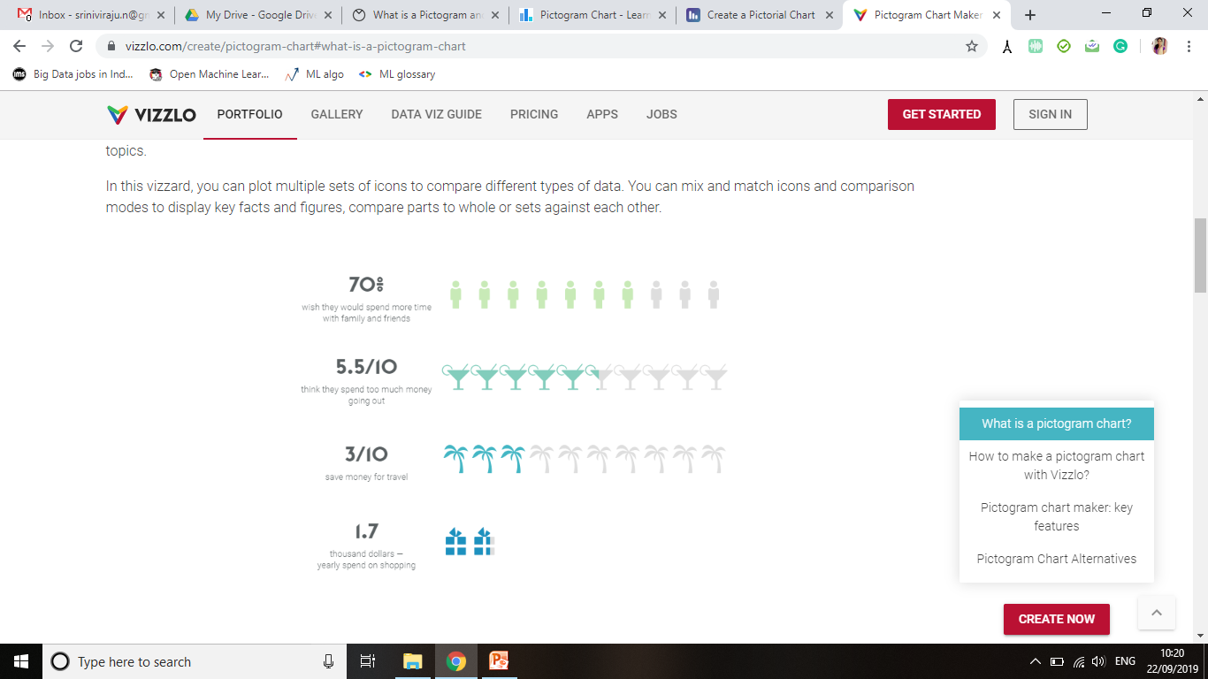
EXAMPLE

Slide 8
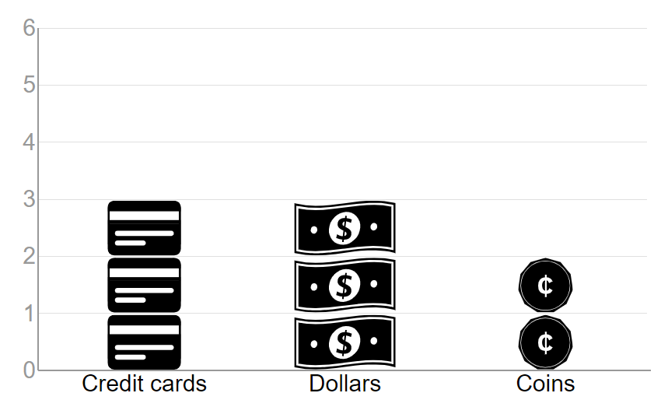
Stacked Pictogram

Slide 9
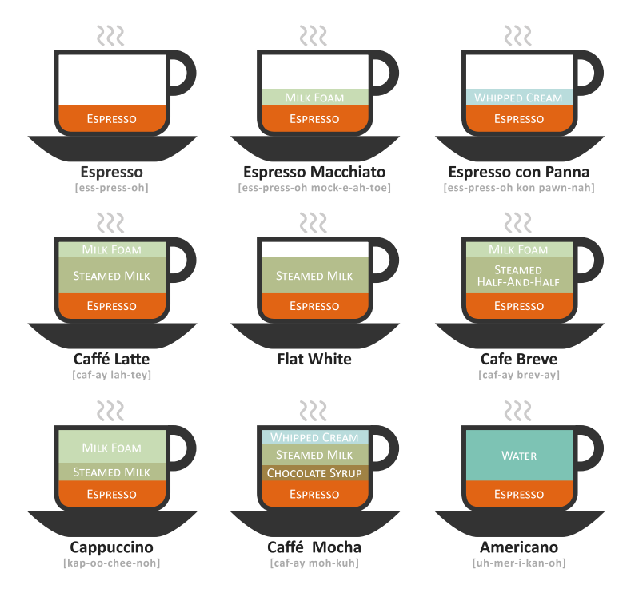
EXAMPLE

Slide 10
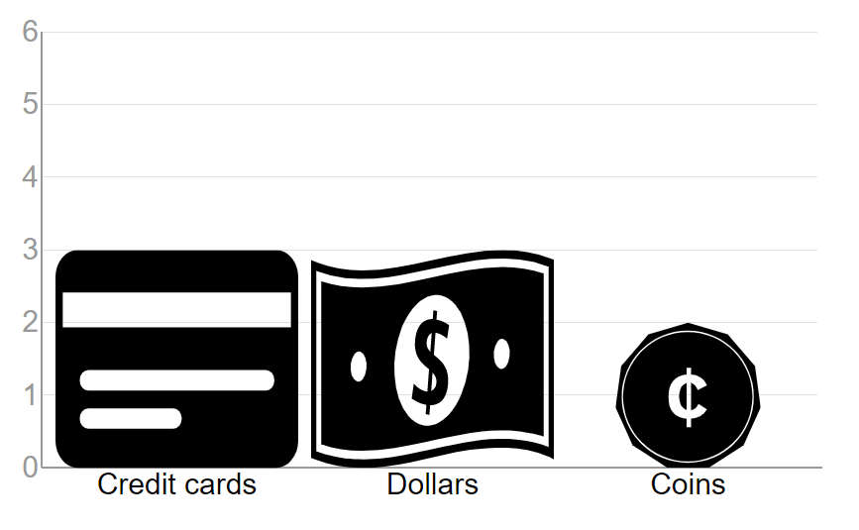
Stretched Pictogram

Slide 11
When to use?
Pictorial charts use icons or pictures in relative sizes to highlight some data pattern and trends, usually to compare the number of units, size or progress.
They are good when comparing few categories with clear differences.

Slide 12
When to avoid?
Displaying partial icons, as this can add confusion to what they represent.
Using them for large data sets, which makes values on the chart hard to count.

Slide 13
Tools
Excel
D3.js
Power point
Power BI

Slide 14
References
https://datavizcatalogue.com/methods/pictogram.html
http://chartmaker.visualisingdata.com/
https://infogram.com/create/pictorial-chart

Slide 15


